Slide 1
Objects

Slide 2
Content
01
What is object?
02
Declaration
03
This
04
JSON

Slide 3
01
Objects
What is an object?

Slide 4
What is an object?
A collection of relative data and functions
It consists of several variables (properties) and functions (methods)
We can add and remove properties .
variable
let student = {
name: "Ivan",
age: 30
}
console.log(student.name)
value
property

Slide 5
Declaring an object
We use object literal {}
We declare an empty object
Subsequently, we add the property
let person = { name: "Ivan", age: 20 };
let person = {};
person.name = "Ivan";
person.age = 20;
person.eyeColor = "blue";

Slide 6
Personal Data
Write a function that gets firstname, lastname and age and returns an object:
{
firstName: "Ivan",
lastName: "Ivanov",
age: 20
}
"Ivan", "Ivanov", 20

Slide 7
Define a method
The functions of an object are called methods:
let person = {
name: "Maria" ,
sayHi(){
console.log('Hi!');
} }
person.sayHi()

Slide 8
This
This refers to the object in which it is located
let person = {
name: "Maria" ,
sayHi(){
console.log('Hi, my name is ', this.name);
} }
person.sayHi()

Slide 9
Built-in features
Object.entries() - Returns an array of all properties and values of the object
Object.keys() - returns an array with all properties
Object.values() - returns an array of all values
We can traverse an object:
let obj = {name: "Maria" ,age:20,grade:6.00}
for ( let key of Object.keys(obj)){
console.log(`${key}: ${obj[key]}`);
}

Slide 10
City data
You get an object that has properties: name, area, population, country and postcode.
Loop through all the properties and print the values.
{
name: "Sofia",
population: 1234567,
country: "Bulgaria",
postcode: 1000
}
name => Sofia
population => 1234567
country => Bulgaria
postcode => 1000

Slide 11
Phonebook
Write a function that accepts an array of name and phone number
Save the name and number in a phone book.
If the name already exists, overwrite the value
["Peter 0888 657 212", "Bob 0877 123 456", "Peter 123123"]
Peter -> 123123
Bob -> 0877 123 456

Slide 12

02
JSON
JavaScript Object Notation

Slide 13
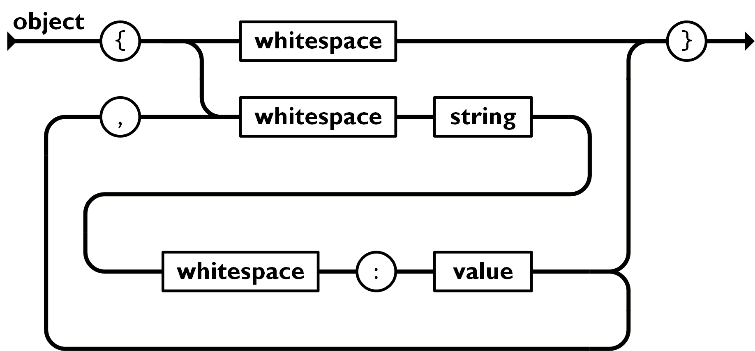
What is JSON?
JSON -> JavaScript Object Notation
Format with which we transfer objects

Slide 14
What we use JSON for
Data transfer between browser and server
JavaScript has built-in functions for reading data from JSON format
{
"name": " Maria",
"age": 20,
"grades": {
"Math": [6.00, 5.50],
"Biology": [6.00]
}

Slide 15
JSON methods
We can convert object to JSON using JSON.stringify(object) method
We can convert JSON to object using JSON.parse(text) method
let text = JSON.stringify(obj);
let obj = JSON.parse(text);

Slide 16
Convert to an object
Write a function that takes a JSON string and turns it into an object.
{
name : " Sofia "
population : 1234567
country : " Bulgaria "
postal code : 1000
}
' {
" name " : "Sofia",
" population " : 1234567,
" country " : "Bulgaria",
" postcode " : 1000
} '

Slide 17
Summary
Objects contain a key and a token
We access the values by key
Objects can contain functions
this refers to the object it is in
Parse and stringify objects in JSON

